Slide 1
EmploymentAbility:
From fixing failure to managing for success
A Point of View
Chris Gibbon and Chris Brailey

Slide 2
Overview of presentation
EmploymentAbility
Why
Review of Challenges
Contemporary Risks
Consequences of failure to act
What
EmploymentAbility: what it is
EmploymentAbility: why it is different
How
Enablers for EmploymentAbility Business Operations Technology Ecosystem and Governance
Implementation
Implementation and change framework

Slide 3
EmploymentAbility: Why

Slide 4
The backdrop to employment: the key challenges
More complex
labour markets
New types of jobs
Globalisation and the demand for skills
Key
Challenges
Old
New
Evolving
New patterns of work: nature of work
Managing the supply of skilled workers
Pressure on costs of social spending
Complexity of the
Employment ecosystem

Slide 5
The backdrop to employment: the key challenges
Active inclusion of
Women
Older people
People with disabilities
Young people
Migrants
More complex
labour markets
High-tech
Digital
Bio/genetic
Low tech services arising from lifestyle changes
New types of jobs
Globalisation and the demand for skills
Economic competitiveness
Demand for new skills
Evolving and changing skills requirements
Emphasis on ‘soft skills’ and ‘Design thinking’
Multiple jobs
Micro jobs
More complex transitions
Career break
Caring
Training
Part time retirement
Key
Challenges
Old
New
Evolving
New patterns of work: nature of work
Managing the supply of skilled workers
Education and training pathways and content (academic and vocational)
Resource supply (home grown vs migration)
Initial and ongoing skills development
Programme affordability
Health technology advances
Dependency ratio
Other priorities
Pressure on costs of social spending
Complexity of the
Employment ecosystem
Multiple players for
Compensation
Job placement
Training
Labour market management

Slide 6
The risks that result from the challenges and the consequences of failure
More complex
labour markets
Contemporary risks
Unaffordability of unemployment compensation
Failure of the labour market
Loss or decay of critical skills
Insufficient skills to be economically competitive
Long term unemployment leading to unemployability
Social risks for individuals, groups and society
Social exclusion through labour market’s failure to deliver for all parts of society e.g. young people
Individual poverty or financial hardship as a result of unemployment
New types of jobs
Globalisation and the demand for skills
Key
Challenges
Old
New
Evolving
New patterns of work: nature of work
Managing the supply of skilled workers
Pressure on costs of social spending
Complexity of the
Employment ecosystem
Consequences of failure to manage risks
Unsustainable public debt
Economic stagnation
Social instability

Slide 7
The risks that result from the challenges and the consequences of failure
‘Our hypothesis is that we are shifting from fundamentally individual level risks (ie income replacement) to fundamentally collective risks (ie market and societal failures)…’
Contemporary risks
Unaffordability of unemployment compensation
Failure of the labour market
Loss or decay of critical skills
Insufficient skills to be economically competitive
Long term unemployment leading to unemployability
Social risks for individuals, groups and society
Social exclusion through labour market’s failure to deliver for all parts of society e.g. young people
Individual poverty or financial hardship as a result of unemployment
Consequences of failure to manage risks
Unsustainable public debt
Economic stagnation
Social instability

Slide 8
Moving forward we need to reflect on the realities of a contemporary working career
Traditional Career Model
School
College
Work
Unemployment
Work
Retirement
Potential repeats
Contemporary Career Model
Unemployment
Career Break
Retirement
Work
Job 1?
Job 2?
Job 3?
Caring
Work
Job 1?
Job 4?
Job 5?
Reduced Hours
School
College
Education/ training
New Job
More variable and complex transitions:
More diversity of risks
Need interventions matched to the transitions and risks
Need products and services to support interventions
Voluntary Work
Voluntary Work
Including combinations
Including combinations
Potential repeats

Slide 9
EmploymentAbility: What

Slide 10
EmploymentAbility: what is it?
Definition
EmploymentAbility is systematically and sustainably maximising employment, over a working lifetime.
To achieve this in the light of contemporary challenges, we need to take a longitudinal, rather than an at-a-point-in-time view.
EmploymentAbility imperatives over a working lifetime
Ensure optimal employment for all
Preventive and proactive
Maintain citizens’ proximity to labour market
EmploymentAbility Key considerations
1) For individuals
Skills acquisition and dynamic maintenance of skills
Ongoing planning and actions throughout a career
2) For Governments and Agencies
Development of proactive EmploymentAbility products and services
Active labour market management – properly integrated with supply side measures
Support for employers to manage temporary shocks and transitional stages
3) For businesses
Proactive skills enhancement of employees
Employment practices reflecting contemporary life patterns

Slide 11
EmploymentAbility: what changes are implied
EmploymentAbility imperatives over a working lifetime
The Big Changes
Big Change 1: A huge expansion in the customer base for services
Big Change 2: A new style of interaction with customers based on a relationship not transactions
Big Change 3: A new Work-Life model with new services and new tools
Big Change 4: Much greater differentiation of customers and differential responses
Big Change 5: Better use of data to support an evidence based approach
Big Change 6: The need to effectively conduct the ecosystem – based on outcomes
Ensure optimal employment for all
Preventive and proactive
Maintain citizens’ proximity to labour market
EmploymentAbility is systematically and sustainably maximising employment, over a working lifetime

Slide 12
EmploymentAbility: How

Slide 13
Business operations, technology and management and governance of the ecosystem
Key Enablers
‘Real’ segmentation of customers – differentiated services and interventions
Concept of ‘sustainable careers’ delivered through an outcome based model
Approach based on customer relationships not transactions
Citizen-centric approach to managing interventions
Improved transitions into work through better job matching
Increase business value though a more data driven approach
A Conductor role across the ecosystem
Optimise the design of the ecosystem business model
Exploit new technology and data management capabilities
The Big Changes
Big Change 1: A huge expansion in the customer base for services
Big Change 2: A new style of interaction with customers based on a relationship not transactions
Big Change 3: A new Work-Life model with new services and new tools
Big Change 4: Much greater differentiation of customers and differential responses
Big Change 5: Better use of data to support an evidence based approach
Big Change 6: The need to effectively conduct the ecosystem – based on outcomes

Slide 14
Business operations, technology and management and governance of the ecosystem
EmploymentAbility Enablers
‘Real’ segmentation of customers – differentiated services and interventions From gross targeting (eg ‘older people’, ‘youth’) to nuanced, evidence based, more granular segments Development of differentiated services and interventions Deploy a variety of interaction styles (from supported self service through to face to face interventions)
Concept of ‘sustainable careers’ delivered through an outcome based model From a job outcome, through a sustainable job, to an actively managed career responding to changes over the working lifetime Alignment of the ecosystem partners through a focus on outcomes
Approach based on customer relationships not transactions Based on a longitudinal (ie lifetime) view Informed through the collection and utilisation of relevant data
Citizen-centric approach to managing interventions Interactions based on citizen need not product Holistic view of needs and responses – across the range of relevant programmes

Slide 15
Business operations, technology and management and governance of the ecosystem
EmploymentAbility Enablers
Improved transitions into work through better job matching by using: A broader range of characteristics eg soft skills Aggregate level data to model and predict outcomes Job matching data and outcomes to drive insight into requirements for new jobs and job families as they emerge
Increase business value though a more data driven approach Evaluation of what works Data led prediction of next best actions Evidence based interventions
A Conductor role across the ecosystem A common view across the ecosystem with shared objectives and driven by the achievement of outcomes, not outputs Co-ordination amongst the players in the ecosystem value chain supported by data
Optimise the design of the ecosystem business model Review ownership of responsibility for risks Review incentives and penalties Build products and services for successful outcomes
Exploit new technology and data management capabilities

Slide 16
Key technology capabilities
Key Enablers
‘Real’ segmentation of customers – differentiated services and interventions
Concept of ‘sustainable careers’ delivered through an outcome based model
Approach based on customer relationships not transactions
Citizen-centric approach to managing interventions
Improved transitions into work through better job matching
Increase business value though a more data driven approach
A Conductor role across the ecosystem
Optimise the design of the ecosystem business model
Exploit new technology and data management capabilities
Key Technology Capabilities
Analytical and segmentation technologies
Service planning and outcome management
Skills planning and management
Case management technologies
Better job matching systems
Master Data Management
Client communication technologies (such as CRM tools and mobile tools)
Collaboration tools
Enabling Technology Infrastructure

Slide 17
EmploymentAbility approaches in practice

Slide 18
Real life examples
Singapore WDA, France Pole Emploi, VDAB
Personal skills account and life long learning for sustainable careers
Concept of ‘sustainable careers’ delivered through an outcome based model
Citizen-centric approach to managing interventions
Approach based on customer relationships not transactions
‘Real’ segmentation of customers – differentiated services and interventions
UK Medway YT NEET project, UK Troubled Families, New Zealand MSD
Early and proactive interventions to secure better employment outcomes
Real’ segmentation of customers – differentiated services and interventions
Approach based on customer relationships not transactions
Increase business value though a more data driven approach
Exploit new technology and data management capabilities
Canada Workers Compensation, UK apprentice levy, Netherlands
Realigning responsibilities and incentives to drive outcomes
Optimise the design of the ecosystem business model

Slide 19
EmploymentAbility: Implementation

Slide 20
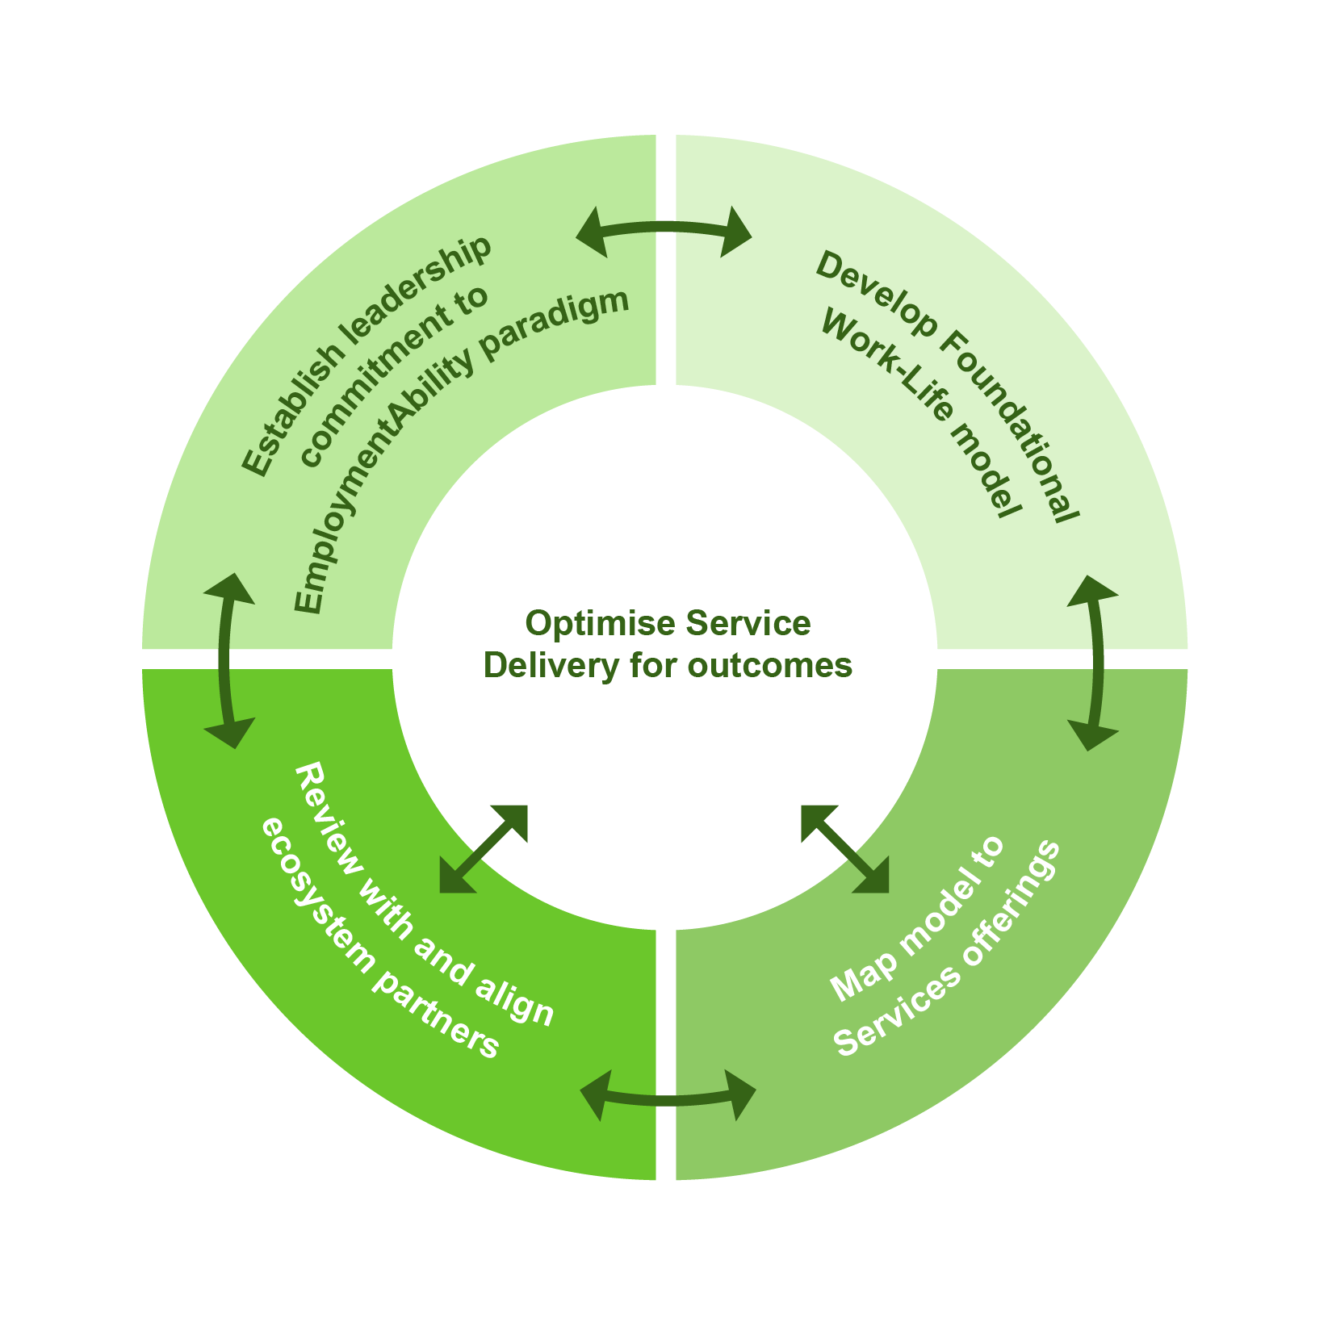
A framework for the journey to an EmploymentAbility model
Implementation in the ecosystem key practicalities
Marathon not a sprint – journey not a project
Avoid ‘boil the ocean’ complexity at start
Build alignment over time
Common language and concept
PES led quick wins and leadership. Projects on:
Segmentation
Adopting a relationship not transaction approach
Citizen centric approach
Better job matching

Slide 21
In conclusion

Slide 22
In conclusion
EmploymentAbility is a coherent framework for addressing contemporary Employment risks
Demands a switch in thinking from dealing with unemployment to maximising employment
It requires the enhancement of existing capabilities and the development of new ones
It is an ecosystem challenge which requires an ecosystem response, making implementation more complex
It’s not ‘pie in the sky’ – examples of key elements already exist
But…. no one size fits all answer…..
PES’s need to have a key role.

