Slide 1
Flexible retirement
EISS Conference 2016
Social Security and the Changing Concept of Work
Oslo, 22 – 23 September 2016
Doc. dr. sc. Ivana Vukorepa
University of Zagreb

Slide 2
Outline:
Why is it an important issue ?
What are countries doing now ?
How should we proceed in the future?
sustainable pension systems with adequate benefits

Slide 3
Why is flexible retirement important?
Demographic aging
Labour market segmentation
Technological progress
Globalization
Pension policy mismanagement
Retirement centered approach
??? Sustainability ???
??? Adequacy ???
Live healthier!
Work longer!
Save more!

Slide 4
Flexible retirement - advantages
complementary to retiremnt age increases
preservation of human capital
allows talent phasing in & out
solution to skill shortage
individual well-being
improves finances

Slide 5
Healthy life years at age 65

Slide 6
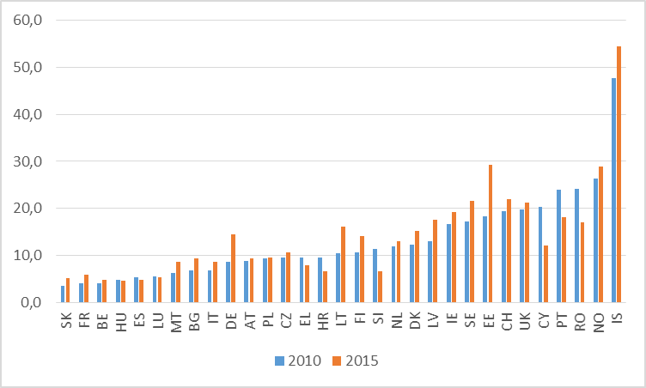
Employment rate from 65 to 69 years
Source: Eurostat

Slide 7
Factors influencing „productive aging”
Health
Family status
Social recognition and contribution
Skills and knowledge
Job opportunities
Financial need
Rewards for working longer
Public policy &
age related legislation !

Slide 8
Current practices to flexible / partial retirement
At what age | After NRA | During early retirement or prior
 | BE, HR, CZ, EE, FI, FR, LU, NL, NO, SE, USA | HR (partial invalidity), SE, LU, NO & USA (subject to earnings t.)
Pension benefit | Full in payment | Reduced by half | Depending on the annual earnings
 | HR, FR, LU, NL, NO, SE, USA (if after NRA) | CZ, USA (NRA-1) | BE, Japan,
Contributions levy | Yes | No
 | HR, EE, Japan CH (earnings t.) | HR (only for casual work), CH (earnings t.), Japan (workers over 70)
Additional pension entitlement | Yes | No
 | HR, EE, CH | HR and CH (if no contributions levied)

Slide 9
Future challenges
State
Labour market participation of elderly
Employer
utilisation of work potential
Individual
healthy life habits
flexible work arrangements
keeping work capacity
Levying contributions and taxes on alternative work arrangements (undeclared work)
Adjusting public sector schemes
Unlinking employment termination to age
less strenuous jobs
Public & private pensions
Early exit pressure (temporary or permanent)
Notes:
Prolongation of working careers is a challenge for everyone: for the individuals, employers and for the state. Future challenges are linked to the policies that should work towards effective increases in the labour market participation of the elderly. Hence, states are responsible for normative framing of consistent policies that will work within their institutional and cultural context.
Regarding labour market policy, it seems to me that employment termination should not be linked to a certain age, or at least that the age limit should be put at the age much higher than the NRA (normal retirement age). Mandatory retirement legislation in the public sector is additionally controversial, because it increases redistribution between the economically active elderly in the private sector and the unproductive elderly in the public sector.
Due to retirement age increases , it is reasonable to expect additional pressures towards early labour market exits: for example due to unemployment, sickness or disability. Apart from activation logic aimed at full health recovery, partial retirement with actuarilly fair reduction of pension benefits might be a good strategy. Alternative work forms, such as voucher work, causal work, crowd work, should be also subject to levying contributions and taxes. We must be careful that those that work in retirement and in these atypical work arrangments do not become cheaper labor compared to other workers, because it could impair the long-term financing of our pension systems. The importance of private pension savings and various pay-out arrangements within multi-pillar pension systems should not be neglected when it comes to non-working phases, and we will have more of those because people will start being tired from work and life.
Employers have the challenge to keep „older” workers in employment and to organise work in such a way as to be able to utilize all their working potential, while individuals should be encouraged to live healthy life styles in order to be able to keep their working capacity.
Freedom to choose an occupation and right to engage in work

Slide 10
One more thing...
Notes:
Francis Bacon. (1561–1626). In his essays „Of youth and Age” wrote about the differences between the young and the old. Among other things he warned that
„Young men are fitter to invent than to judge; fitter for execution than for counsel; and fitter for new projects than for settled business.
Men of age object too much, consult too long, adventure too little, repent too soon, and seldom drive business home to the full period, but content themselves with a mediocrity of success.
Certainly it is good to compound employments of both„
So Francic Bacon a long time ago recognised the need to combine in emplyoemnt the vigour of the young and the vigilance of the old. And the combination of the two is presented in these pictures.

Slide 11
Vigor of the young and the vigilance of the old!

